Slide 1
POLI 202 The Government of Canada
Canadian Federalism

Slide 2
Outline
What is a federation?
The Canadian Federation (1867)
The Evolution of Canadian federalism
Fiscal Federalism

Slide 3
What is a federation?
What is a federation?
A system in which political authority is divided between two or more constitutionally distinct orders of government
Federations are also characterized by specific institutions.
Each is autonomous in its juridictions. (Equal, no hierarchy)

Slide 4
What is a federation?
They will have:
A Senate: Represents federated entities (region, province, state). Protects less populous regions from domination by other bodies.
A Constitution: Spells out which order of government has jurisdiction, power over portfolio.
A Supreme Court: : Acts as arbiter if conflict between federal and other governments.

Slide 5
What is a federation?
Federations are often used to manage regional identities.
If a country is made up of several groups that have different goals, a federal structure can be useful.
Issues that are consensual can be managed at the federal level, while other issues can be managed in the provinces.

Slide 6
What is a federation?
While doing so can help manage identities, they can also increase regional tensions and conflicts.
This is because they create institutions and powers that reinforce this feeling of regional identity.
They give a regional group a voice, a Parliament, a leader (the premier), etc. (budget)
These assets can be used to strengthen their claim and accentuate regional demands.

Slide 7
What is a federation?
Questions?

Slide 8
The Canadian Federation
Three reasons for the Canadian federation:
Political
Economic
Military

Slide 9
The Canadian Federation
In 1840, the Upper and Lower Canadas were united in the Province of Canada.
This venture led to political deadlock.
Each language group blocked the priorities of the other group, leading to frustration.

Slide 10
The Canadian Federation
At the same time, the colonies experienced economic pressure.
Britain was going to rescind preferential treatment for colonies, which would hurt their economy.
The colonies were also in debt and unable to borrow money for further economic development.
Uniting would lead to a common market, which would help them sell goods to more customers.

Slide 11
The Canadian Federation
Finally, the colonists were scared of their neighbour to the South.
They noticed that the United States were expansionist, and knew that there had been conflicts between the UK and the United States.
They thought they could better defend themselves as a group rather than separately.
Federation was partly a military alliance.

Slide 12
The Canadian Federation
For some English-speaking politicians, including Sir John A. Macdonald, this meant a united country just like the UK.
A single Parliament would oversee all of Canada, and govern all provinces centrally.
Macdonald believed the provinces would be to the federal government as colonies to the Empire.

Slide 13
The Canadian Federation
Quebec politicians, however, were concerned that they would be put at a disadvantage among all the other English parliamentarians.
As a result, they insisted on a federation.
They argued that they could handle key responsibilities at the federal level, but maintain autonomy in other jurisdictions.
NB and NS also agreed with this position, given their small weight in the federal House of Commons.

Slide 14
The Canadian Federation
We should not conclude that the Canadian federation followed exactly the expectations of Quebec.
Despite dividing responsibilities between federal and provincial governments, there are many measures that limit the powers of the provinces.
In this sense, the early federal arrangement is often described as a quasi-federation.

Slide 15
The Canadian Federation
This can be seen in the role of institutions:
The Senate did not really represent provinces, as senators are named by the Prime Minister.
The Supreme Court did not exist in 1867.
The constitution did not include an amendment procedure.

Slide 16
The Canadian Federation
Section 91 of the Constitution spells out the responsibilities of the federal government.
The federal government received the essential powers to manage a country.
It states that the federal government is responsible for « peace, order, and good government » in Canada.

Slide 17
The Canadian Federation
Some of the jurisdictions of the federal government:
Defence
International relations
Banking
Currency
Trade
Reflects the priorities at the time: political, military, economic.

Slide 18
The Canadian Federation
The federal government was also given special powers which explain the label of quasi-federation.
The Prime minister is responsible for naming the provincial lieutenant-governors. (representative of the Crown at the provincial level)
Power of reserve
Power of disallowance
Declaratory power

Slide 19
The Canadian Federation
Power of reserve
This power states that the lieutenant-governor can refuse to give the Royal Assent to provincial bills.
Instead, they could forward the bill to the Governor General to make the decision (which in practice would be made by the federal government).
In practice, this power was used rarely, and was last used in 1961.

Slide 20
The Canadian Federation
Power of disallowance
This power gives the federal government the right to cancel any law adopted by a province within 1 year of its adoption.
Unlike the previous, this power was used often at the beginning of federation.
However, the last time was in 1943, and it is unclear if it would be considered relevant today.

Slide 21
The Canadian Federation
Declaratory power
The declaratory power gives the federal government the power to declare one of the provincial jurisdictions to be of national interest, and then make it a federal jurisdiction
This can include the national interest or the interests of many provinces.
This has been used to gain jurisdictions over nuclear energy and railways, for instance.
The power has been used over 400 times, and was used last in 1961.

Slide 22
The Canadian Federation
Residual Powers
A last clause claims that the federal government will obtain any power not included in the Constitution.
Any new areas created over time (say, Communications, air travel) would fall automatically under federal jurisdictions.
This means that the power of the federal government over the provinces will grow over time.

Slide 23
The Canadian Federation
Despite these limitations, provinces still received wide powers.
Education
Healthcare
Social Policy
Culture
Civil Law
Cities

Slide 24
The Canadian Federation
There are also many jurisdictions where there is overlap between the federal and provincial governments.
Environment
Agriculture
Taxation
Immigration
Pension
Pensions were originally provincial, but became a federal jurisdiction in the 1960s. Quebec, however, chose to create its own provincial pension system, and Alberta is currently studying the possibility of doing the same.

Slide 25
The Canadian Federation
Questions?

Slide 26
The Evolution of Canadian Federalism
We just established that the initial federal arrangement in Canada was not really federal.
However, Canadian federalism today feels more balanced.
What happened?

Slide 27
The Evolution of Canadian Federalism
The premiers argued against the power of the federal government.
They said that the federation was a compact among the Provinces, rather than the provinces being dependent on the federation.
The provinces organized politically to counter federal power.

Slide 28
The Evolution of Canadian Federalism
Provinces gained greater power versus the federal government by going to the Judicial Committee of the Privy Council, a body responsible for legal appeals in the British Commonwealth.
Two landmark judgments clarified the roles and responsibilities of each order of government.
In 1892, the committee ruled that provinces have full sovereignty in their jurisdictions and are thus not the subordinates of the federal government.

Slide 29
The Evolution of Canadian Federalism
In 1896, the JCPC reviewed how the « peace, order, and good government » clause should be interpreted.
It cannot be interpreted broadly for the federal government to take over provincial jurisdictions.
They rule that it only applies to cases of national emergency, such as war.
Likewise, the powers of the federal government over trade only apply to interprovincial or international trade,

Slide 30
The Evolution of Canadian Federalism
Questions?
Notes:
End here on Tuesday

Slide 31
Fiscal Federalism
Definition: The evolving system of financial arrangements between the federal and provincial orders of governments
In Canada, the two orders of government are fairly independent from each other
Most responsibilities are divided, not shared.
Wide taxation powers for both levels of government

Slide 32
Fiscal Federalism
Both governments perceive:
Personal Income tax
Corporate Income tax
Sales taxes (GST, PST/HST)
Payroll taxes (CPP/QPP, EI)
The federal government also perceives customs and excise duties
Provinces collect taxes related to natural resources and vice (gambling, alcohol, marijuana)
Municipalities perceive property taxes

Slide 33
Fiscal Federalism
Fiscal federalism serves to remedy gaps between governments:
The vertical fiscal gap: Gaps between federal government and provinces.
The horizontal fiscal gap: Gaps across provinces.

Slide 34
Fiscal Federalism
In order to remedy these gaps, the federal government uses a variety of programs:
The CHT (Canada Health Transfer)
The CST (Canada Social Transfer)
Equalization payments

Slide 35
Fiscal Federalism
Even though the federal and provincial governments both have the right to perceive taxes, there is a certain level of financial interdependence in the federation.
This is due to many factors:
The quasi-federation of 1867 favoured the federal government;
Different provinces have different means;
There is competition for sources of funding between the provinces and between the federal and provincial governments;

Slide 36
Fiscal Federalism
Equalization payments
They are payments made by the federal government to poor provinces.
The principle behind equalization payments is that every province should be able to offer services beyond a minimal national standard.
So, for instance, every province should be able to offer its citizens education, healthcare, and a social safety net.

Slide 37
Fiscal Federalism
There is inequality across the provinces.
If we let provinces handle these services on their own, there may be strong discrepancies between services to citizens of rich provinces vs. citizens of poor provinces.
Equalization payments serve to remedy this problem.

Slide 38
Fiscal Federalism
Equalization payments are guaranteed in the Constitution since 1982.
They are unconditional, meaning that the federal government cannot request that a province do something (or cease to do something) to receive this payment.
This has led some to criticize the program, arguing that recipients should be forced to change their economy to make it more competitive.

Slide 39
Fiscal Federalism
Equalization payments lead to some heated debates in Canada.
This is because these funds only benefit poorer provinces.
Citizens from rich provinces pay taxes to the federal government, but receive nothing from equalization.

Slide 40
Fiscal Federalism
In equalization debates, recipient provinces are called « have not provinces » and provinces that do not receive equalization are called « have provinces ».
Have not provinces receive money based on the strength of their economy, but also the total number of citizens in the province.
This is because the goal of equalization is to fund services, and social services will cost more as the population increases.

Slide 41
Fiscal Federalism
The next slide illustrates the role of equalization in the provinces’ finances.
The red bar illustrate the ability of each province to generate revenue per capita on its own, without equalization. It shows big differences (Alberta is about twice as high as PEI).
The blue bars represent the effect of equalization. It shows that equalization payments help have-not provinces reach a minimal Canadian standard. Have provinces do not receive this payment, but still remain above this Canadian standard (BC, AB, SASK, NL).
The value of equalization per capita for each province can be found at the bottom of the graph as well.
Credit for the graphs go to Prof. Trevor Tombe from the University of Calgary.

Slide 42
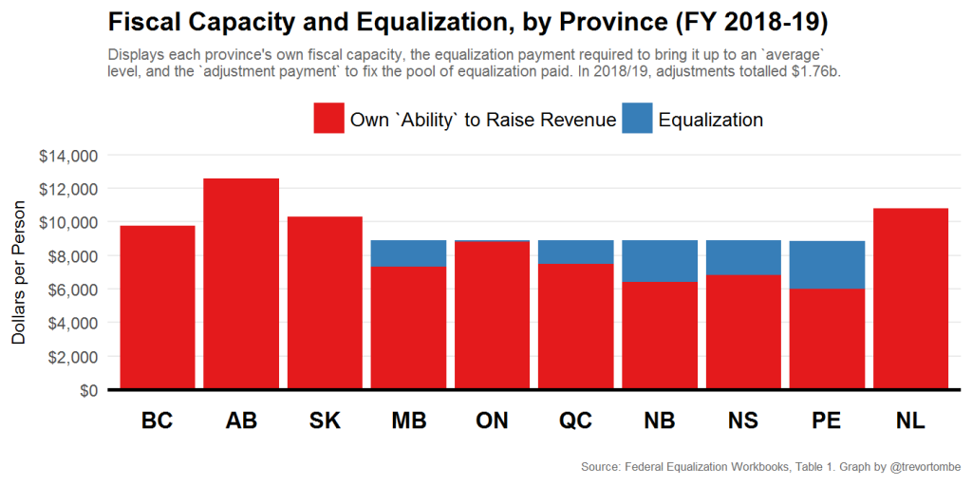
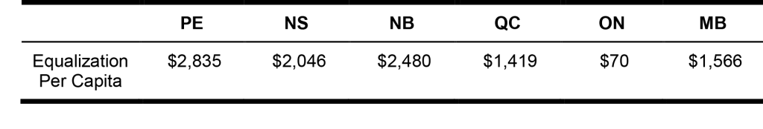
Fiscal Federalism

Slide 43
Fiscal Federalism
Questions?

Slide 44
Fiscal Federalism
Another aspect of fiscal federalism touches upon the idea of the federal government’s spending power.
The federal spending power in Canada has been defined as “the power of Parliament to make payments to people or institutions or governments for purposes on which it [Parliament] does not necessarily have the power to legislate.”

Slide 45
Fiscal Federalism
What this means in layman’s terms is that the federal government can spend money in areas of jurisdictions that are not its own.
This is why the federal government can give money to postsecondary students in the form of scholarships or contribute to healthcare.
As long as federal programs involve spending money but not influence legislation, this is acceptable according to the doctrine of the federal spending power.

Slide 46
Fiscal Federalism
The federal spending power is not recognized explicitly in the Constitution.
However, it has been used extensively by Canadian governments at least since the middle of the 20th century.
It has never been directly challenged in the Supreme Court.

Slide 47
Fiscal Federalism
This may seem completely fine at first.
If the federal government is only giving money away to provinces, why complain?
One issue is that the federal government can associate these payments to certain conditions.
In doing so, they can influence provinces to adopt programs that are not the ones their population wants.

Slide 48
Fiscal Federalism
The federal spending power is thus an indirect way for the federal government to influence provincial policy.
It can do so by imposing national standards, and letting provinces choose the means of attaining these standards.
It can also outright state what the new policy should be.
This can threaten the division of power between the provinces and equality of the two orders of government.

Slide 49
Fiscal Federalism
This is especially an issue in a context when provinces have limited funds and growing expenses.
In such a situation, provinces may not really have the possibility to say no to federal transfers.
In this case, the federal government gets the power to influence provincial policy or force the provinces to have a deficit.

Slide 50
Fiscal Federalism
One could argue that provinces could just raise their taxes to fund their own programs.
There are two obstacles to this:
The federal government already taxes citizens, and there is a limit to how much citizens can be taxed.
Some provinces are too poor to generate that much from their own taxes. They need to rely on outside funding.

Slide 51
Fiscal Federalism
This thus leads to a conundrum.
On one side, the spending power ensures national standards and contributes to equality among the provinces.
On the other side, it endangers the sovereignty of provinces in their jurisdictions.

Slide 52
Fiscal Federalism
The two most important uses of the federal spending power target healthcare and social welfare.
The Canada Health Transfer (CHT), which requires provinces to meet the standards of the Canada Health Act.
The Canada Social Transfer (CST), which requires provinces to distribute social assistance to all residents without minimum residency requirements.

Slide 53
Fiscal Federalism
Other programs are referred to as shared programs.
In such programs, the federal government funds 50% and the province the other 50%.
Shared cost programs are criticized by provinces because they force them to adopt and fund the priorities of the federal government.

Slide 54
Fiscal Federalism
These programs have led some provinces to argue for the right to opt-out of such programs with the funds.
Their argument is that the federal government should not be spending in provincial jurisdictions, and that such funds reveal a vertical fiscal imbalance.
The federal government has agreed to do so in some cases, while requiring that provincial programs have similar aim to the federal programs.

Slide 55
Fiscal Federalism
Direct spending occurs when the federal government gives money directly to institutions or individuals for reasons related to provincial jurisdictions, effectively bypassing provincial governments.
Some early examples include unemployment insurance and old age pensions.
These responsibilities have since then been given to the federal government.

Slide 56
Fiscal Federalism
More recent examples include:
The Millenium Canada scholarships
Transfer of funds to municipalities
The universal child benefit
The Canada child benefit

Slide 57
Fiscal Federalism
Questions?

